Slide 1
Hardware Monitor
Administrator Training
Real-time device health • Email alerts • Firmware tracking • Performance metrics
Valley City State University | Capstone Project | March 2026
Larry Herzog Jr.

Slide 2






Agenda
What the Monitor Tracks
Dashboard Walkthrough
Filtering by Device Type
Email Alert System
Configuration & Exclusions
Access via Admin Portal

Slide 3
What the Monitor Tracks
Visibility across your entire UniFi stack

Slide 4
Three Data Sources, One Dashboard
Protect API
Access API
Network API
UNVR Pro
UNVR Pro :12445
Cloud Key Gen2+
• Cameras (status, firmware, uptime)
• Door access hubs (online status)
• Access points (CPU, mem, firmware)
• NVR (CPU, memory, temp, storage)
• Switches (CPU, temp, firmware)
• Cloud Key (CPU, mem, uptime)
Collected metrics: Online/offline status, CPU %, memory %, temperature, firmware version, uptime, NVR storage.

Slide 5
Dashboard Walkthrough
Understanding the monitoring interface

Slide 6
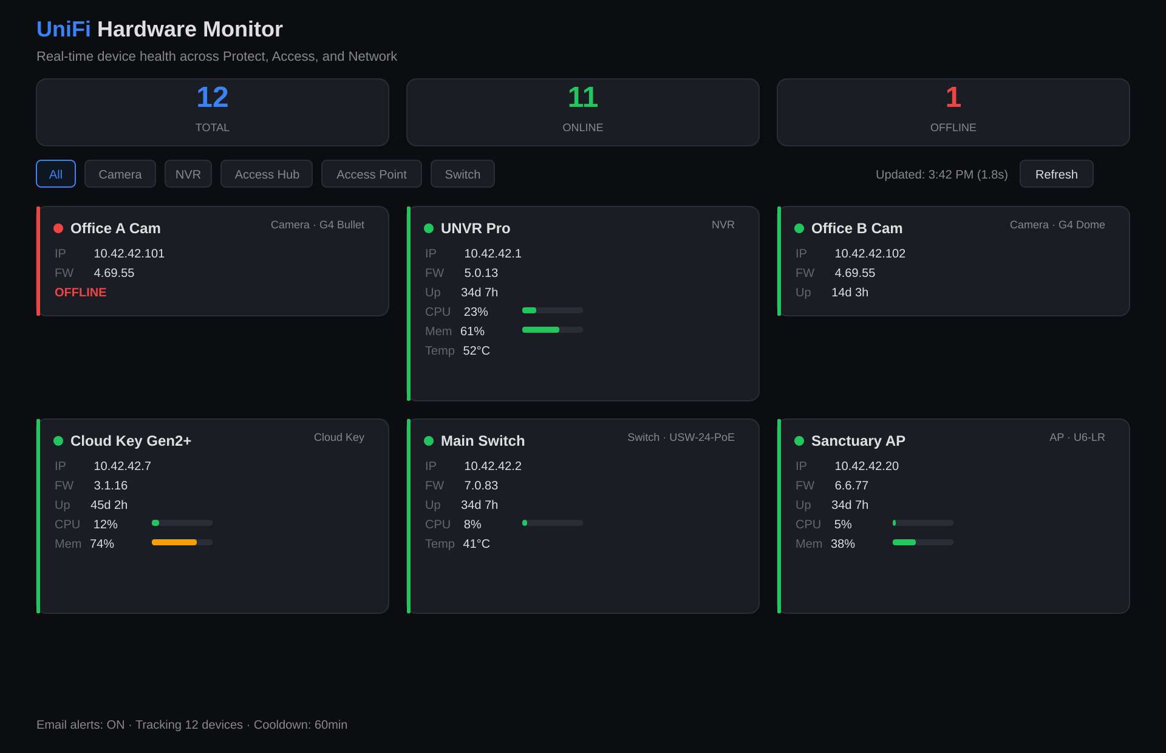
The Monitoring Dashboard

Slide 7
Dashboard Elements
Summary Cards
Total, Online, and Offline counts at a glance. Offline count turns red when devices are down.
Device Cards
Each device shows: status dot (green/red), name, type, IP, firmware, uptime, and performance bars for CPU/memory.
Filter Buttons
Click a device type to show only that category. 'All' returns to the full view. Offline devices always sort to the top.
Auto-Refresh
Dashboard refreshes from cached data every 30 seconds. Background poller hits the APIs every 2 minutes. Click Refresh for immediate update.

Slide 8
Reading Performance Indicators
Metric | Green (OK) | Amber (Warning) | Red (Critical)
CPU | < 70% | 70% – 90% | > 90%
Memory | < 70% | 70% – 90% | > 90%
Temperature | < 65°C | 65°C – 80°C | > 80°C
Offline devices: Shown with a pulsing red dot and sorted to the top of the grid for immediate visibility.
Not all devices report all metrics: Access hubs show only online status. Older APs may not report temperature. This is normal.

Slide 9
Email Alert System
Automatic notifications on device status changes

Slide 10
How Email Alerts Work
Device Down Alert
Recovery Notification
Sent when a device transitions from online to offline or unreachable. Includes device name, type, IP, and the status change.
Sent when a device transitions from offline back to online. Confirms the issue has resolved without manual intervention.
Smart Alert Behavior
• Cooldown: 1-hour window per device. If a device flaps, you only get one alert per hour (configurable).
• Batching: Multiple status changes in the same poll cycle are combined into one email.
• First run: After service restart, the first poll establishes a baseline — no alert flood.
Delivery: Alerts sent via Gmail SMTP with TLS encryption. Configure in config.py (SMTP settings).

Slide 11
Configuration & Exclusions
Tuning the monitor to your needs

Slide 12
Key Configuration Options
Setting | Default | Purpose
POLL_INTERVAL | 120 sec | How often the monitor checks all APIs
ALERT_COOLDOWN | 3600 sec | Minimum gap between alerts for same device
SMTP_ENABLED | False | Set True after configuring Gmail app password
ALERT_TO | [] | List of email recipients
EXCLUDED_DEVICES | [] | Device names to hide from dashboard and alerts
Config file: sudo nano /opt/unifi-monitor/config.py — then restart: sudo systemctl restart unifi-monitor
Exclusion list: Add device names (case-insensitive) to EXCLUDED_DEVICES to hide noisy or non-critical devices.

Slide 13
Access via Admin Portal
Monitor tab in the unified dashboard

Slide 14
Two Ways to Access
Standalone Dashboard
Admin Portal > Monitor Tab
http://<server-ip>:5002
http://<server-ip>:8080#monitor
Full experience: device grid with filtering, CPU/memory/temperature bars, auto-refresh every 30 seconds.
Summary view: device list with status, firmware, uptime. Click "Full Dashboard" for the complete interface.
No login required: Both interfaces are accessible from the management VLAN without authentication.

Slide 15
Quick Reference
Task | How
View full dashboard | http://<ip>:5002
View via portal | http://<ip>:8080 > Monitor tab
Filter by device type | Click filter buttons (Camera, NVR, Switch, etc.)
Check service status | sudo systemctl status unifi-monitor
View logs | sudo journalctl -u unifi-monitor --since today
Edit configuration | sudo nano /opt/unifi-monitor/config.py
Test email alerts | Run the test script from README.md
Restart after config change | sudo systemctl restart unifi-monitor

Slide 16
Questions?
Thank you for attending.

